Slide 1
China Pakistan Economic Corridor (CPEC)
By Muhammad Ajmal Khan

Slide 2
Historical background of China Pakistan Economic Corridor
One Belt One Road initiative of China in the 21st Century.
Six corridors of OBOR and CPEC is one of them which the most functional one among them.
Gwadar port attracted the Chinese government to invest in Pakistan in terms of CPEC.

Slide 3
Worth of China Pakistan Economic Corridor
CPEC was proposed by China in 2013 and signed in 2015
Worth $46 billion to $65 billion
Include Fiber optics, roads, railway lanes, pipelines, etc.
Divided into three categories; Short term, mid Term and Long term projects which will take 15 years to complete.
Motive behind the corridor

Slide 4
Problems and Prospects of China Pakistan Economic Corridor
Most of the projects are in the advanced stage and about to complete
More projects are yet to be added to the mega project when required.
Due to its long duration there are chances to be affected by some internal and external factors as well.

Slide 5
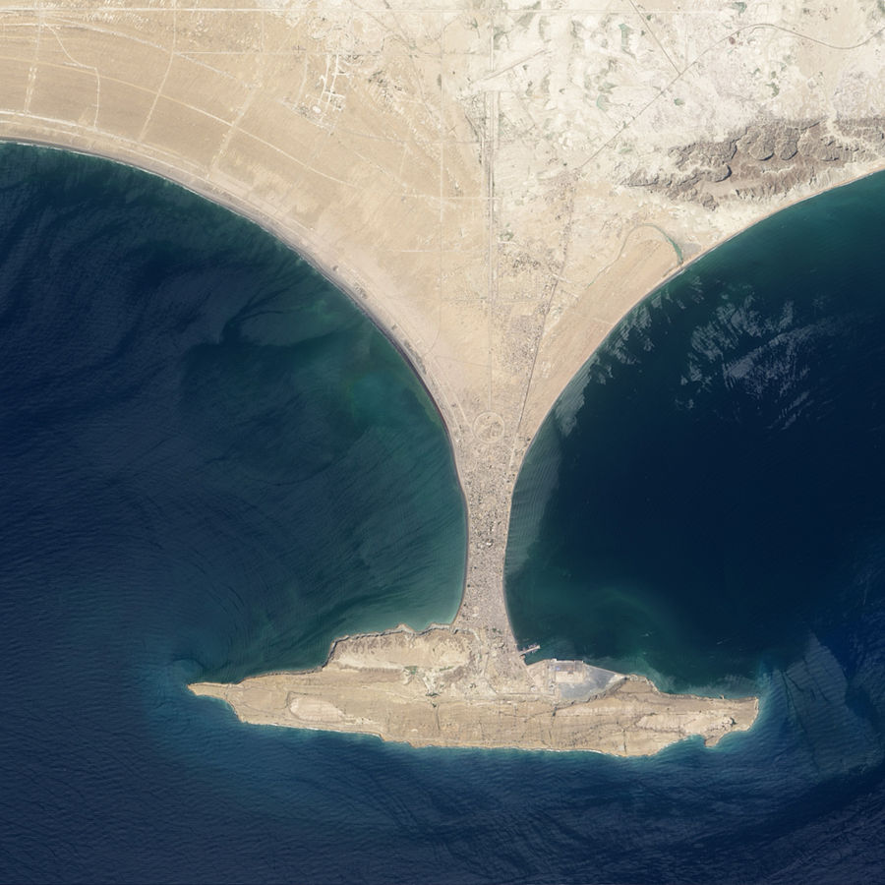

Slide 6
Impacts of China Pakistan Economic Corridor
CPEC is a prosperous project for Pakistan, a golden opportunity that can change the fate of Pakistan.
There are many positive impacts of CPEC; Boost economy, Employment, development of the industrial sector and will connect the whole country, etc.
No doubt there are negative impacts of CPEC too; Environmental effects can destroy Pakistani industry, Chinese can overwhelm the country, replace Pakistani labors with Chinese, etc.

Slide 7
Main Theme
CPEC is a mega project worth more than $62 billion and will take fifteen years to complete. CPEC is very well known for its prosperity and will boost the economy of Pakistan and all that but the problem is that CPEC is not full of milk and honey at all. Because there are many barriers in its way to completion. Even in the implementation stage, there are lots of challenges in terms of internal and external threats from the surroundings. Additionally, Pakistan is not in a position to adjust to the advancement of such projects because China is more advance than Pakistan in every field of life even though Pakistan cannot compete with its economy. So, the government of Pakistan needs attention to respond to this project sincerely and I have concluded from my research that recently Pakistan is in such a position that she can take advantage of CPEC and destroy herself in the implementation of this project. So, it’s up to the government of Pakistan how it is responding to the project.

Slide 8
Impacts of CPEC
Chinese products in Pakistani markets.
Challenges during CPEC implementation are; Uncertainty in Afghanistan, Baloch insurgency, CPEC dividends, etc. Route controversy.
People of Gwadar and advancement of CPEC.
Environmental impact in Pakistan.
Unskilled labors and disappointment. 332 skills of CPEC.
Disputed areas of Kashmir and GB
Paying $90 billion to the Chinese government till 2030 is impossible for Pakistan.
US and China are rivalries

Slide 9
Will it be another East India company?
Baluchistan will not separate from Pakistan.
We have already been affected by English after 1947 and now the Chinese language is affecting Urdu.
Pakistan will get better infrastructure
India financed Iran’s Chahbahar port to compete with Pakistan’s Gwadar port.
The completion of this project will promote Tourism in Pakistan.
China’s incomplete project in Sri Lanka and some parts of Africa.
Chinese presence in other countries is not a threat.
China’s Western region has a resemblance to Baluchistan in terms of rich resources, land, and least development.
It is still in the hands of Pakistan whether to lose or gain from the project.

Slide 10
Foreign Policy with India

Slide 11
Quaid-i-Azam’s Stance on Foreign Policy
“Our foreign policy is one of friendliness and goodwill towards all the nations of the world. We do not cherish aggressive designs against any country or nation. We believe in the principle of honesty and fair play in national and international dealings and are prepared to make our utmost contribution to the promotion of peace and prosperity among the nations of the world. Pakistan will never be found lacking in extending its material and moral support to the oppressed and suppressed peoples of the world and in upholding the principles of the United Nations charter”

Slide 12
Background of Pak-India Relations
India claims Kashmir to be its integral part and Pakistan claims it as its‘ Jugular vein’.
India is considered to be Pakistan’s enemy since both countries have been separated in 1947 on the bases of religious nationalism.
To maintain the balance of power in the region, most of the budget of these countries spend on defense. Along with this, both countries have the status of Nuclear power due to which this region (South Asia) is considered as the danger zone on earth in terms of war.
Since its inception, Pakistan being a nascent state has been facing problems like regional instability, water issues, disputed areas, and insecurity from the Indian side.
Both countries have fought almost four wars: the 1948 Kashmir issue, the 1965 Operation Gibraltar, the 1971 Separation of East Pakistan, and the 1999 Kargil War.

Slide 13
Kashmir Issue: Bone of contention between India and Pakistan
The 3rd June Plan (Partition of British India)
There were a total of 562 Princely States including Kashmir
During the partition in 1947, approximately 500 princely states joined India and supported the Indian Congress. While 14 Princely states supported the cause of Pakistan and joined Pakistan accordingly. There were only 3 Independent Princely States who had joined non of the above (Junagarh, Hyderabad, and Kashmir)
Kashmir was the second largest Princely State of United India.

Slide 14
Kashmir Issue
Area and population: It has an area of 84000 sq miles. According to the 1941 census, its population was about 4.4 million. Amongst them, 3.07 were Muslims.
Both the Hindus and Muslims wished to convince the Kashmiris but the Hindus were somehow aggressive in getting Kashmir. Consequently, the Kashmiri Muslims revolted against the Hindu’s tyranny due to which the Maharaja showed favor towards India.
Facing the Muslim revolts in Kashmir, the Maharaja had to flee from the valley of Kashmir on October 24, 1947, and seek refuge and wrote a letter to Mountbatten to send the Indian Army to control the situation and the Indian army did the same as expected.
To respond to the Indian army, the government of Pakistan sent the army and the tribal Pathans from KPK.
Violation of the plebiscite.

Slide 15
Kashmir Issue and the United Nations
Pakistan welcomed the intervention of the UN
Decision of the Security Council: Ceasefire between the two countries, Truce agreement and demilitarization of the State Jammu and Kashmir and a council of commission for India and Pakistan was made to follow the instructions of cease fire.
India implemented article 370 on Kashmir which was intended to establish a representative government in Kashmir.
Ayub Khan’s meeting with Nehru in 1959 over Kashmir
Six Round table talks on Kashmir

Slide 16
Relations with Afghanistan
Pakistan and Afghanistan is sharing a long border of 2250 KM. Along with this, both the countries are sharing same religion and culture.
Conflict over Durand Line
The Soviet Invasion and Pakistan’s participation in the War.
Afghan refugees and Pakistan’s response
War on Terror Al-Qaida attack on World Trad Centre on 9 September 2001, popularly called as 9/11.
Loss in war on Terror

Slide 17
Diplomatic Initiatives
Peace Talks with Taliban
Trilateral Dialogue- Pakistan, China and Afghanistan
Indian presence in Afghanistan and Pakistan’s response
US exit from Afghanistan

